Slide 1
UNIT-III SATELLITE LINK DESIGN

Slide 2
UNIT-III: SATELLITE LINK DESIGN
Basic Transmission Theory
System Noise Temperature and G/T Ratio
Design of Down links
4. Uplink Design
5. Design of Satellite Links for Specified C/N
6. System Design Example.

Slide 3
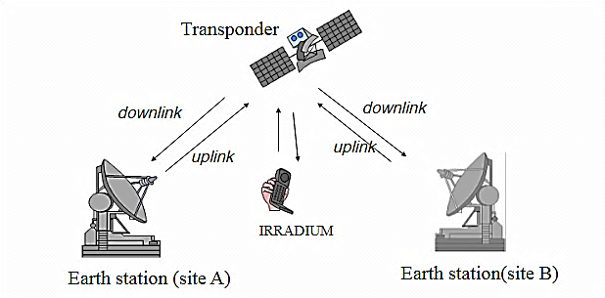

Slide 4
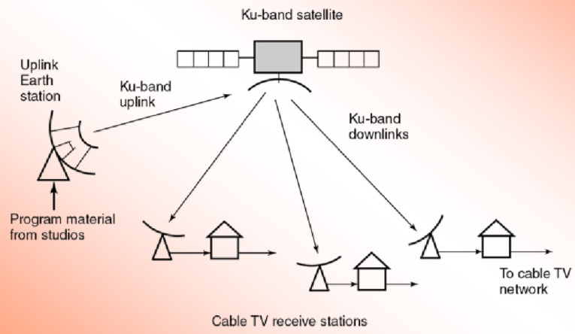

Slide 5
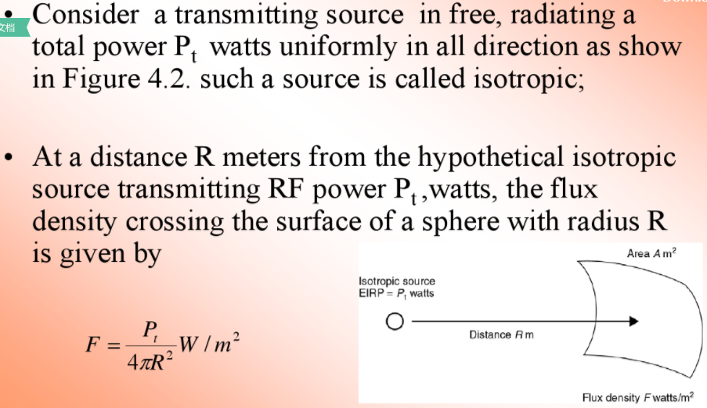
1. Basic Transmission Theory
Figure 4.2 Flux Density produced by an Isotropic source

Slide 6
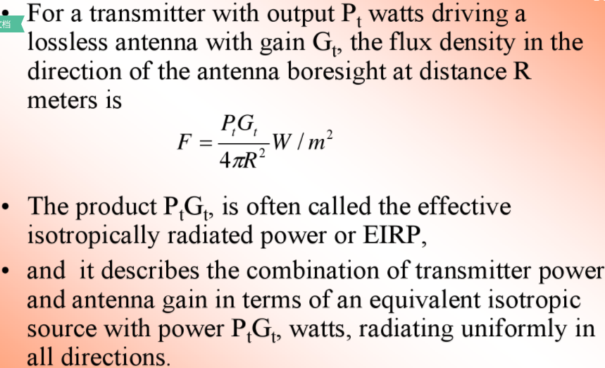

Slide 7
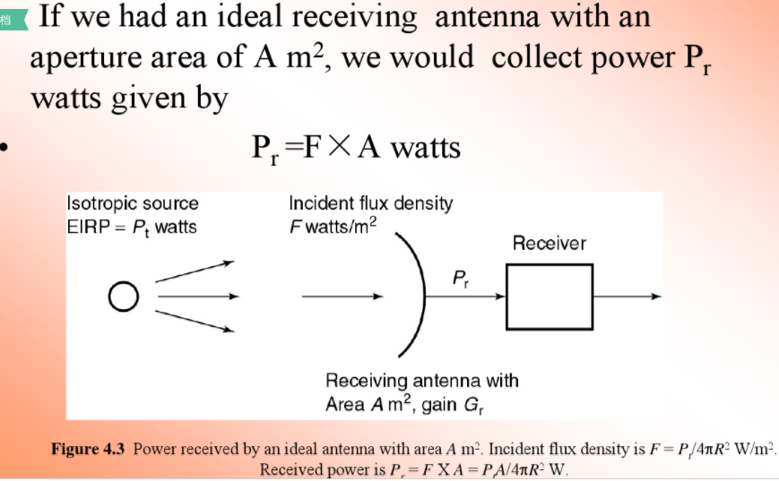

Slide 8
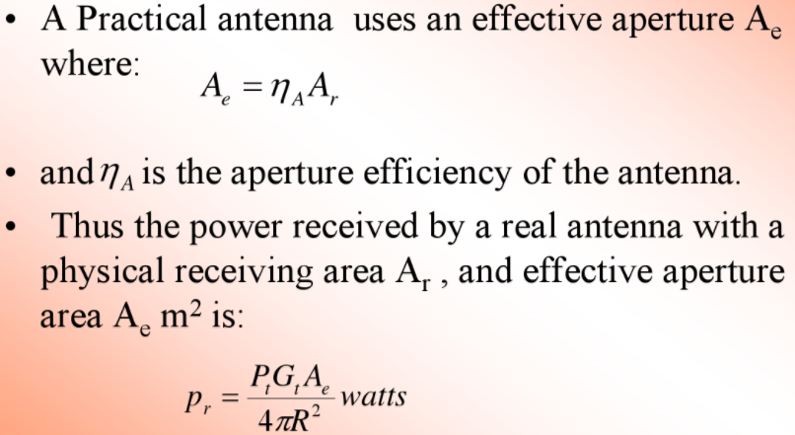

Slide 9
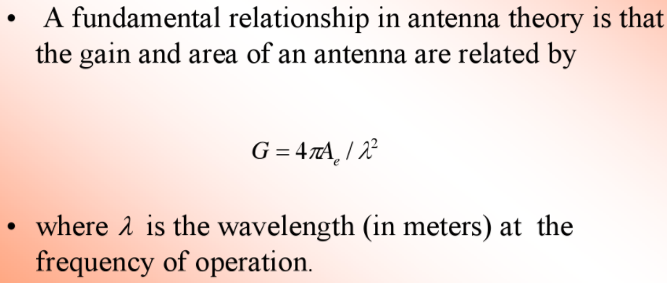
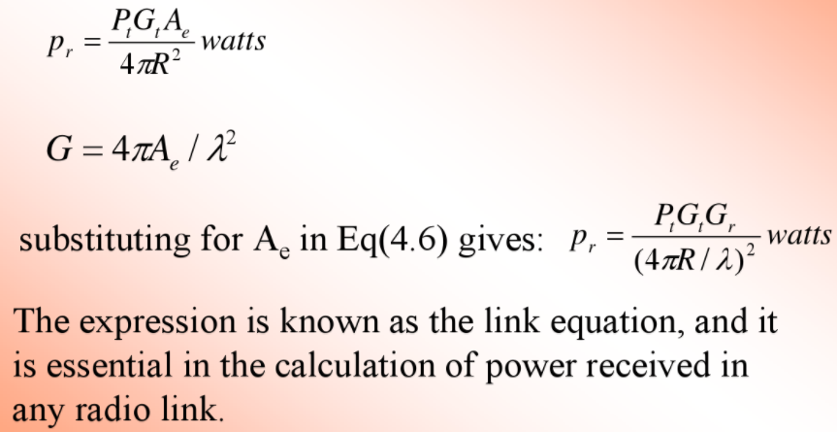

Slide 10
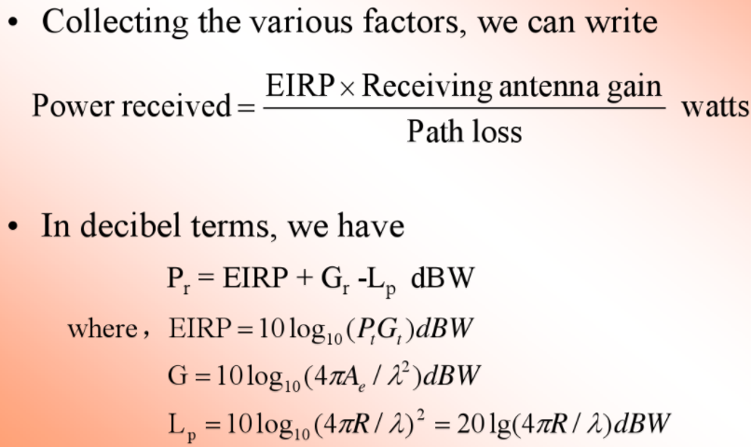

Slide 11
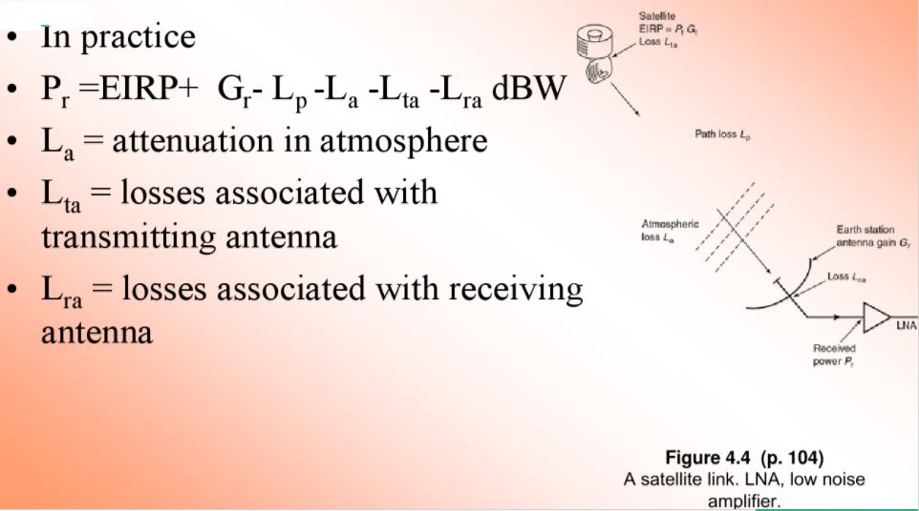

Slide 12
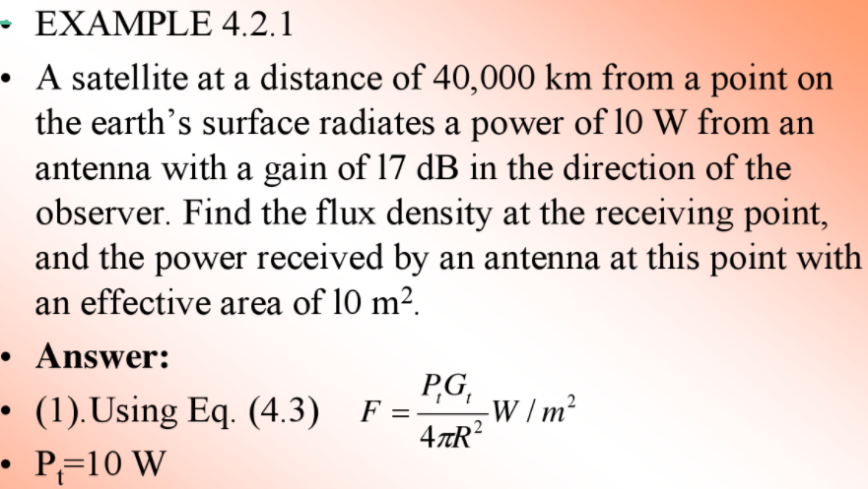
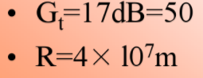

Slide 13
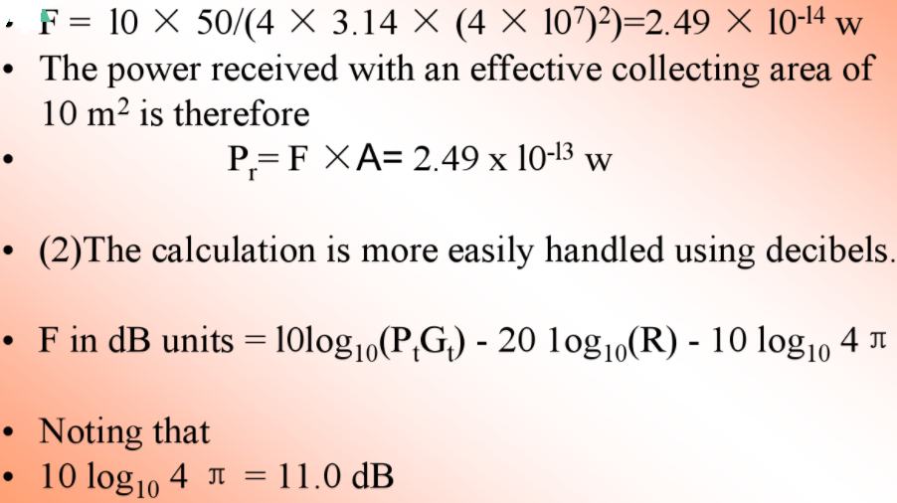
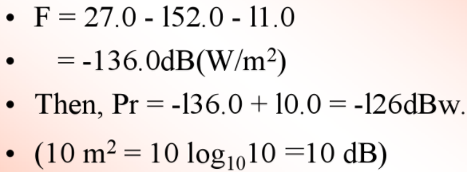

Slide 14
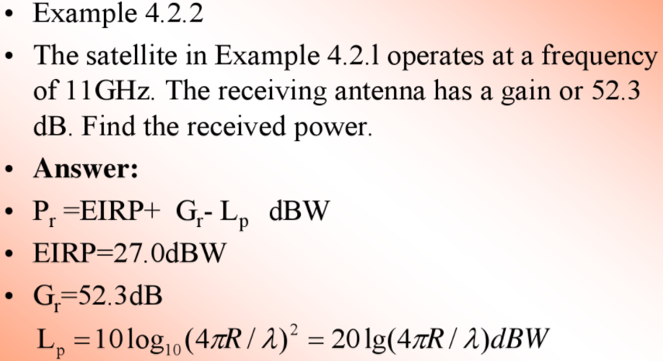
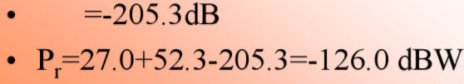

Slide 15
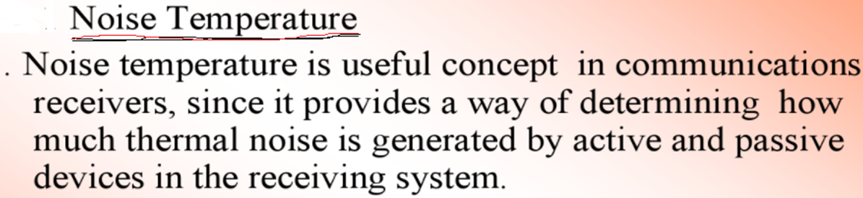
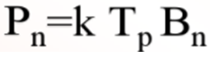
2. System Noise Temperature and G/T Ratio
At Microwave frequencies, a black body with a physical temperature, Tp degrees Kelvin, generates electrical noise over a wide bandwidth.
The noise power is given by
(Black Body-The energy of radiation emitted by the body at wavelength)

Slide 16
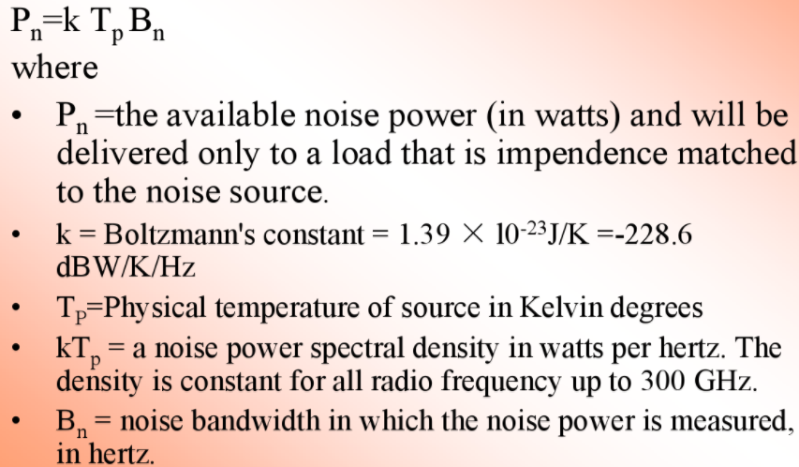

Slide 17
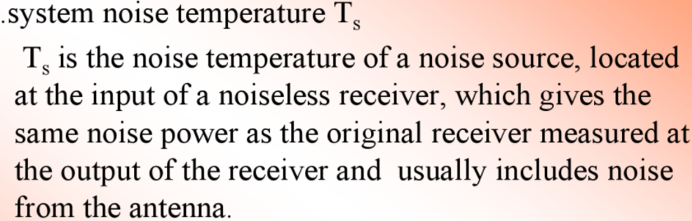
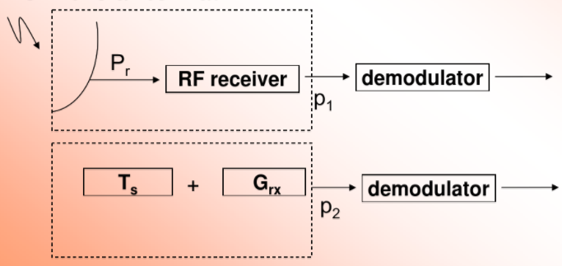
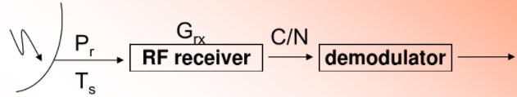

Slide 18
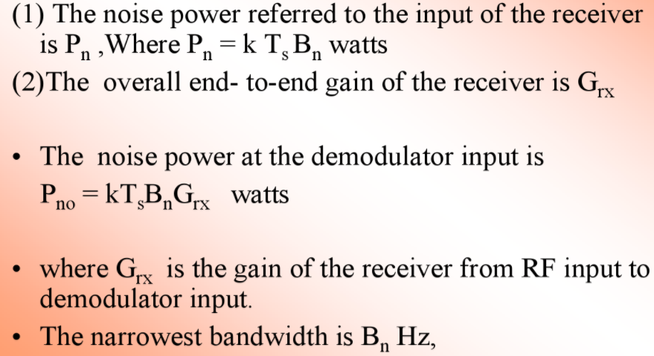

Slide 19
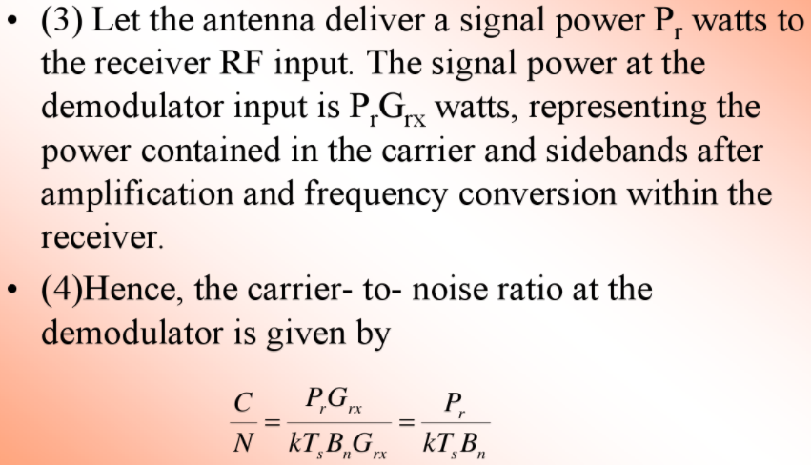

Slide 20
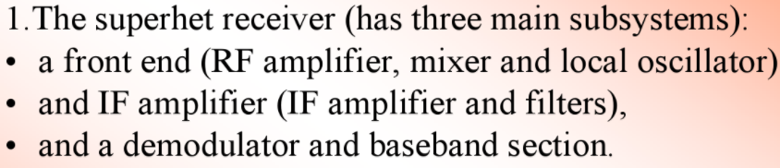
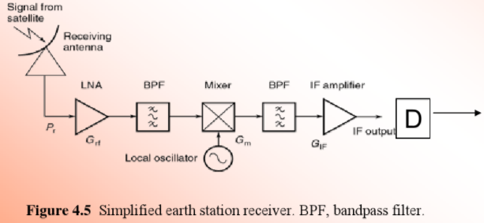
Calculation of System Noise Temperature

Slide 21
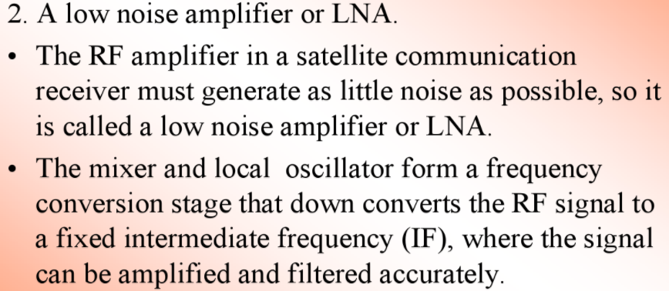

Slide 22
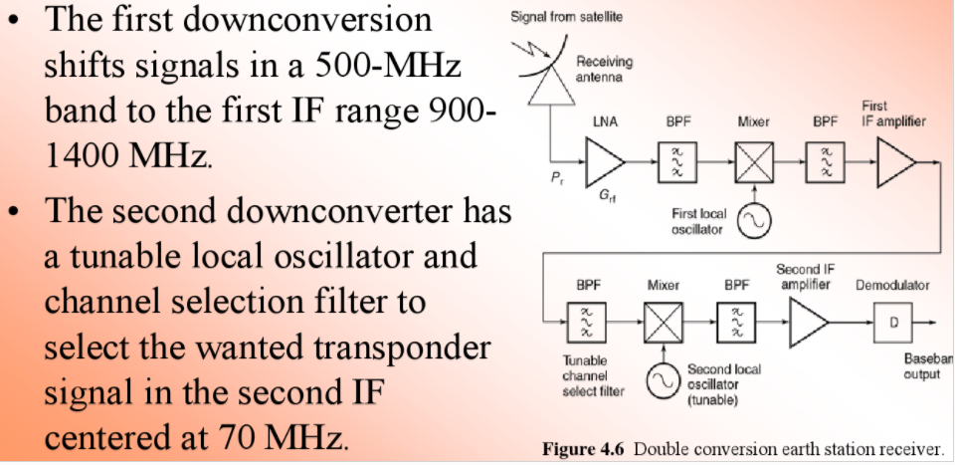

Slide 23
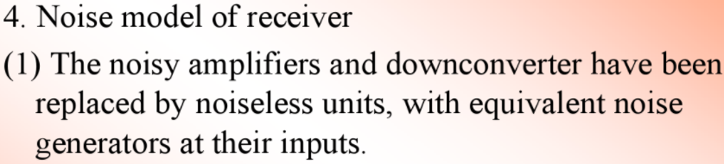
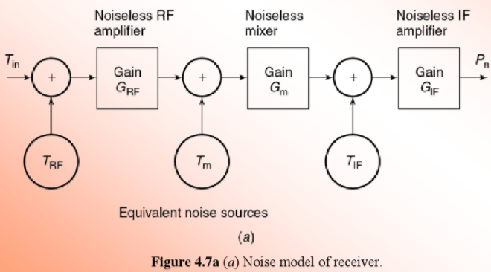
9`ATYU0- ,./

Slide 24
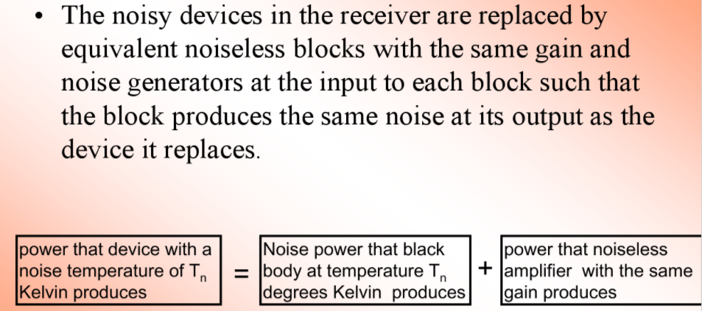

Slide 25
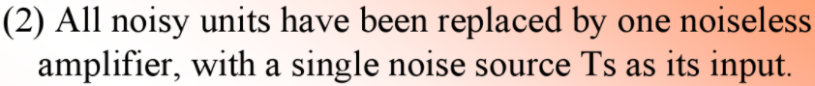
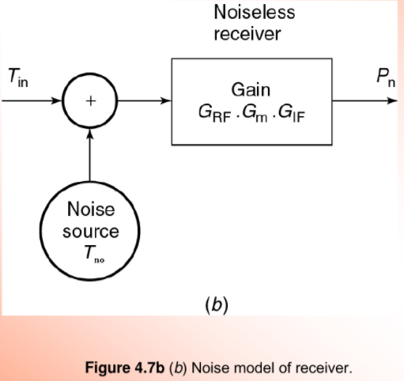

Slide 26
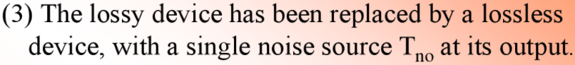
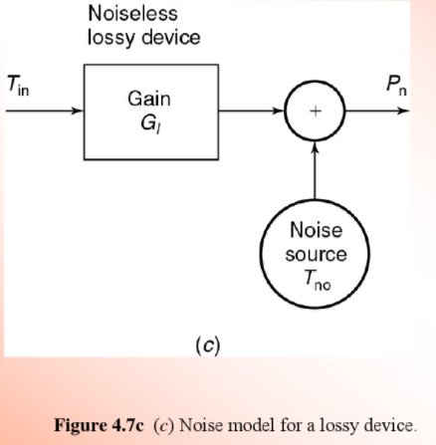

Slide 27
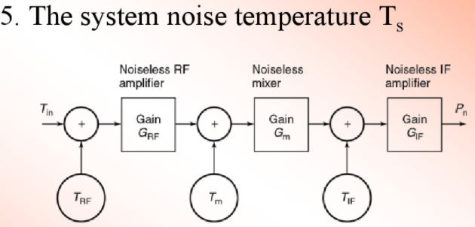
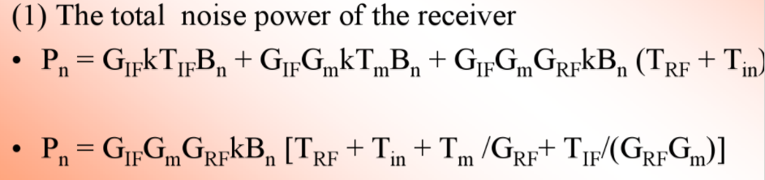
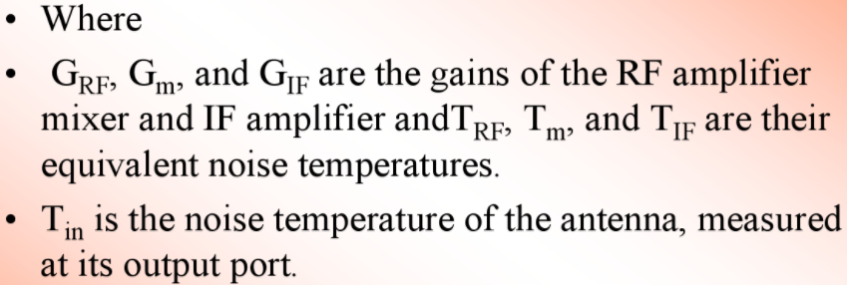

Slide 28
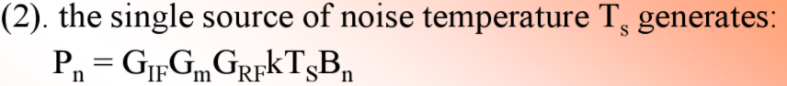
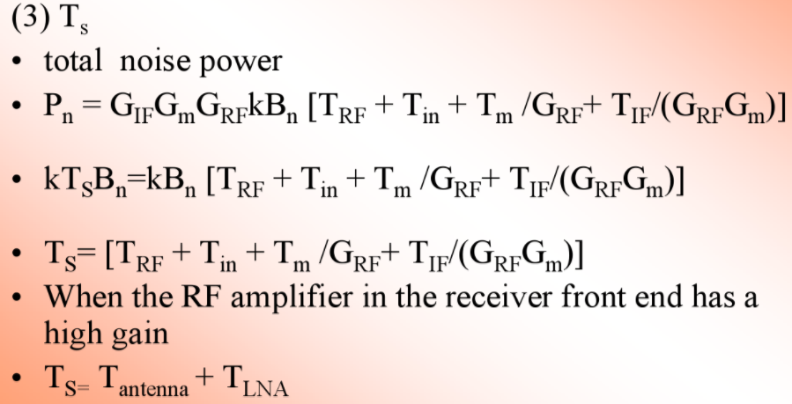

Slide 29
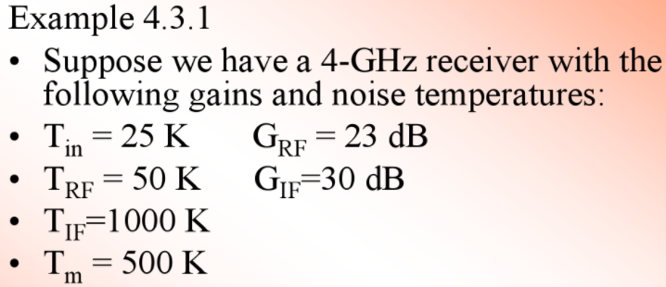
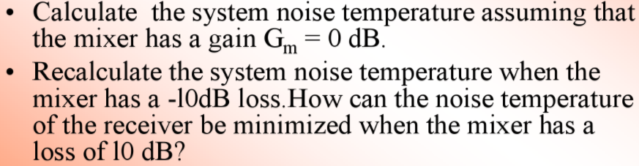

Slide 30
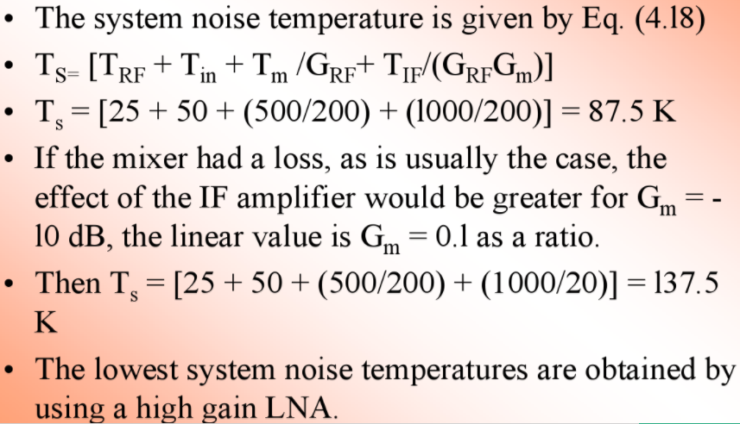

Slide 31
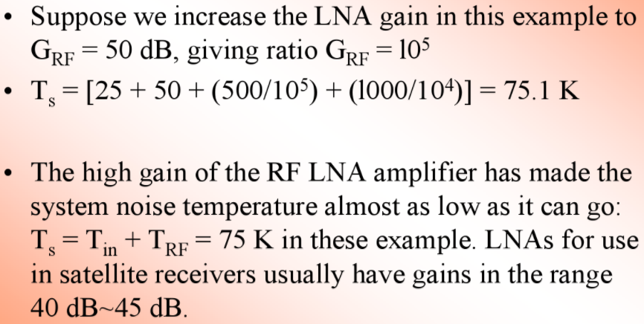

Slide 32
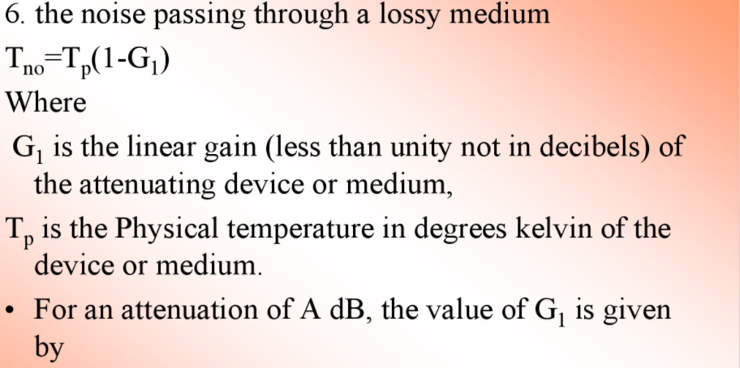
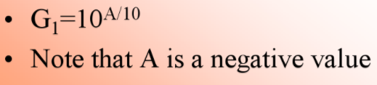

Slide 33
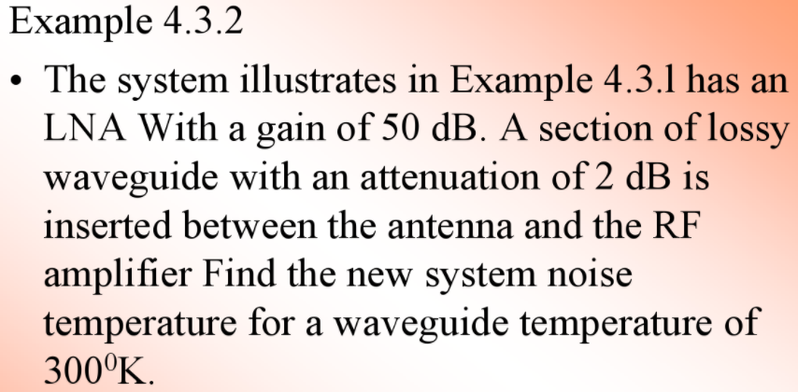
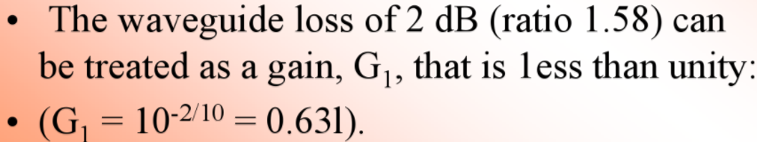

Slide 34
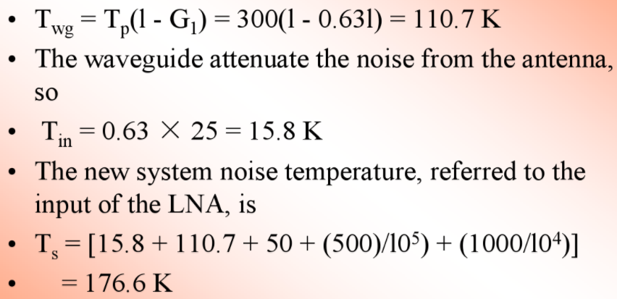

Slide 35
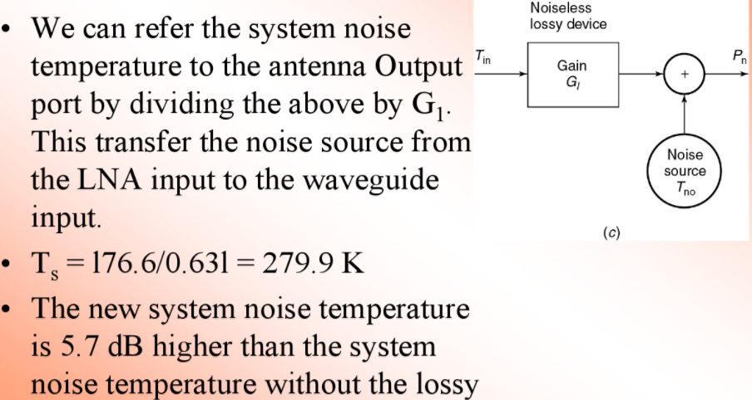


Slide 36


Slide 37

Noise Figure and Noise Temperature

Slide 38


Slide 39


Slide 40

G/T Ratio for Earth Stations
Let the antenna deliver a power P_{r} to the receiver RF input
The signal power at the demodulator input is P_{r} G_{rx} watts
Carrier –to-noise ratio at the demodulator is,

Slide 41


Slide 42


Slide 43


3. DESIGN OF DOWNLINKS

Slide 44


Slide 45

3.1 Link Budgets

Slide 46


Slide 47


Slide 48



Slide 49


3.2: Link Budget Example: C-Band Downlink for Earth Coverage Beam

Slide 50



Slide 51



Slide 52


Slide 53


Slide 54


Slide 55


Slide 56


Slide 57





Slide 58

4. UPLINK DESIGN

Slide 59

VSAT (Very Small Aperture Terminal)

Slide 60


Slide 61



Slide 62




Slide 63

5. DESIGN FOR SPECIFIED C/N: COMBINING C/N AND C/I VALUES IN SATELLITE LINKS

Slide 64



Slide 65


Slide 66


5.1: Overall (C/N)0 with Uplink and Downlink Attenuation

Slide 67


5.2: Uplink and Downlink Attenuation in Rain

Slide 68



Slide 69



Slide 70

5.3: Satellite Communication Link Design Procedure

Slide 71


Slide 72


Slide 73


